Slide 1
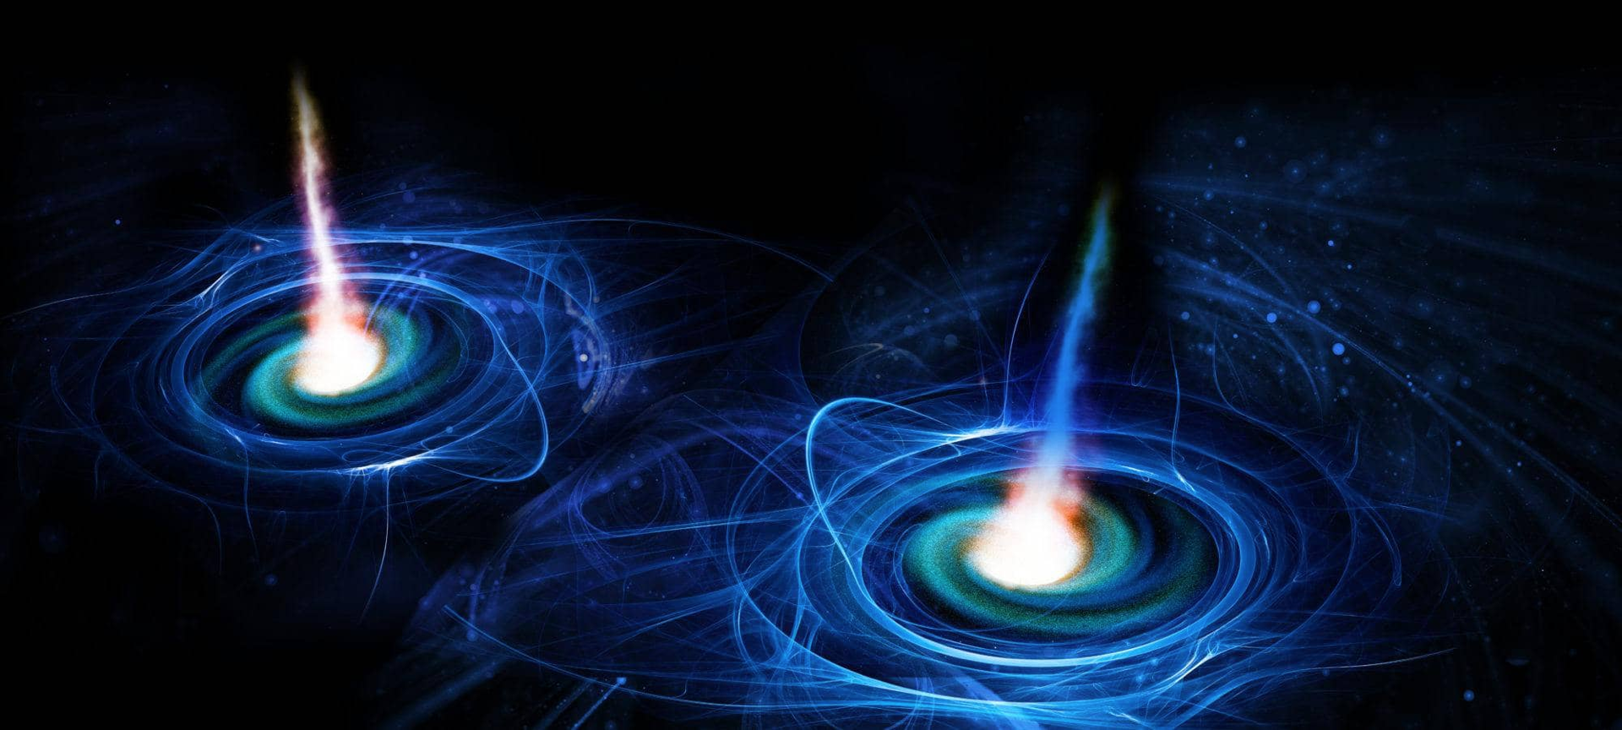




PULSAR TIMING RESPONSE
DUE TO GRAVITATIONAL WAVES
Stephen Taylor
Assistant Professor of Physics & Astronomy
VANDERBILT UNIVERSITY, Nashville TN
Chair, NANOGrav Collaboration
VU PTA GW Summer School, July 9 2024

Slide 2
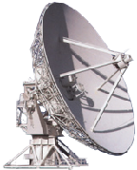
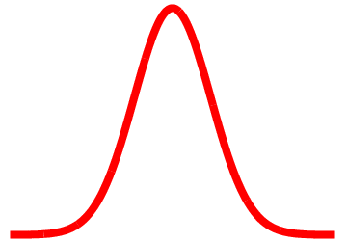
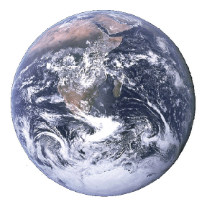



Sophisticated timing model for each pulsar includes spin period, spindown rate, astrometric effects, interstellar-medium dispersion, etc.
Credit: NANOGrav Space Public Outreach Team
Stephen R. Taylor
VU PTA GW Summer School | July 9 2024
Notes:
We can build sophisticated timing models for each pulsar that are parametrized by the spin rate, spin-down rate, astrometric effects, pulsar binary system effects, the electron density of intervening ISM, and more.

Slide 3

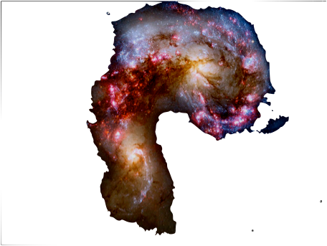
Gravitational Waves change the proper separation
between Earth and pulsar.
Pulses arrive ahead of or behind schedule
Credit: NANOGrav Space Public Outreach Team
Stephen R. Taylor
VU PTA GW Summer School | July 9 2024
Notes:
When a gravitational wave transits the Earth-pulsar line of sight, it distorts the intervening space-time, changing the proper separation.
Pulses arrive earlier or later than in flat space-time, as predicted by the fiducial timing model.

Slide 4
Derivation

Slide 5
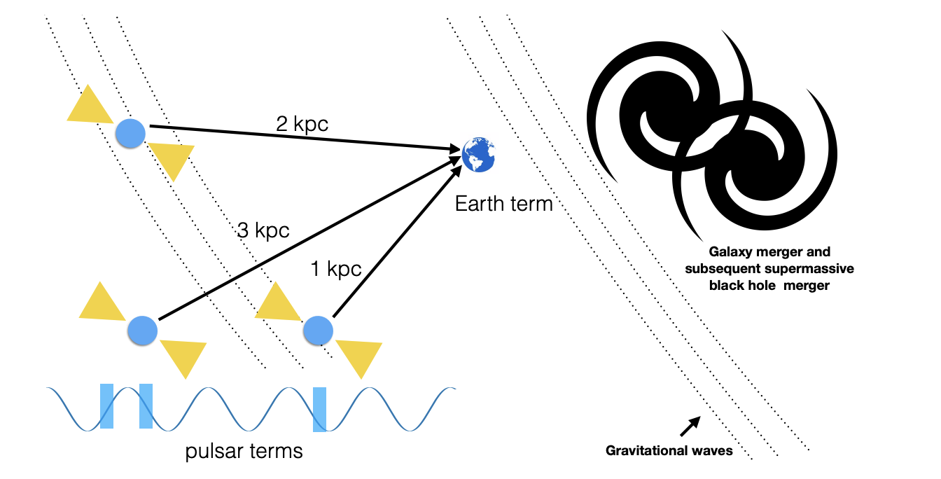
Image credit: Burke-Spolaor et al. (2019)
Stephen R. Taylor
VU PTA GW Summer School | July 9 2024

Slide 6
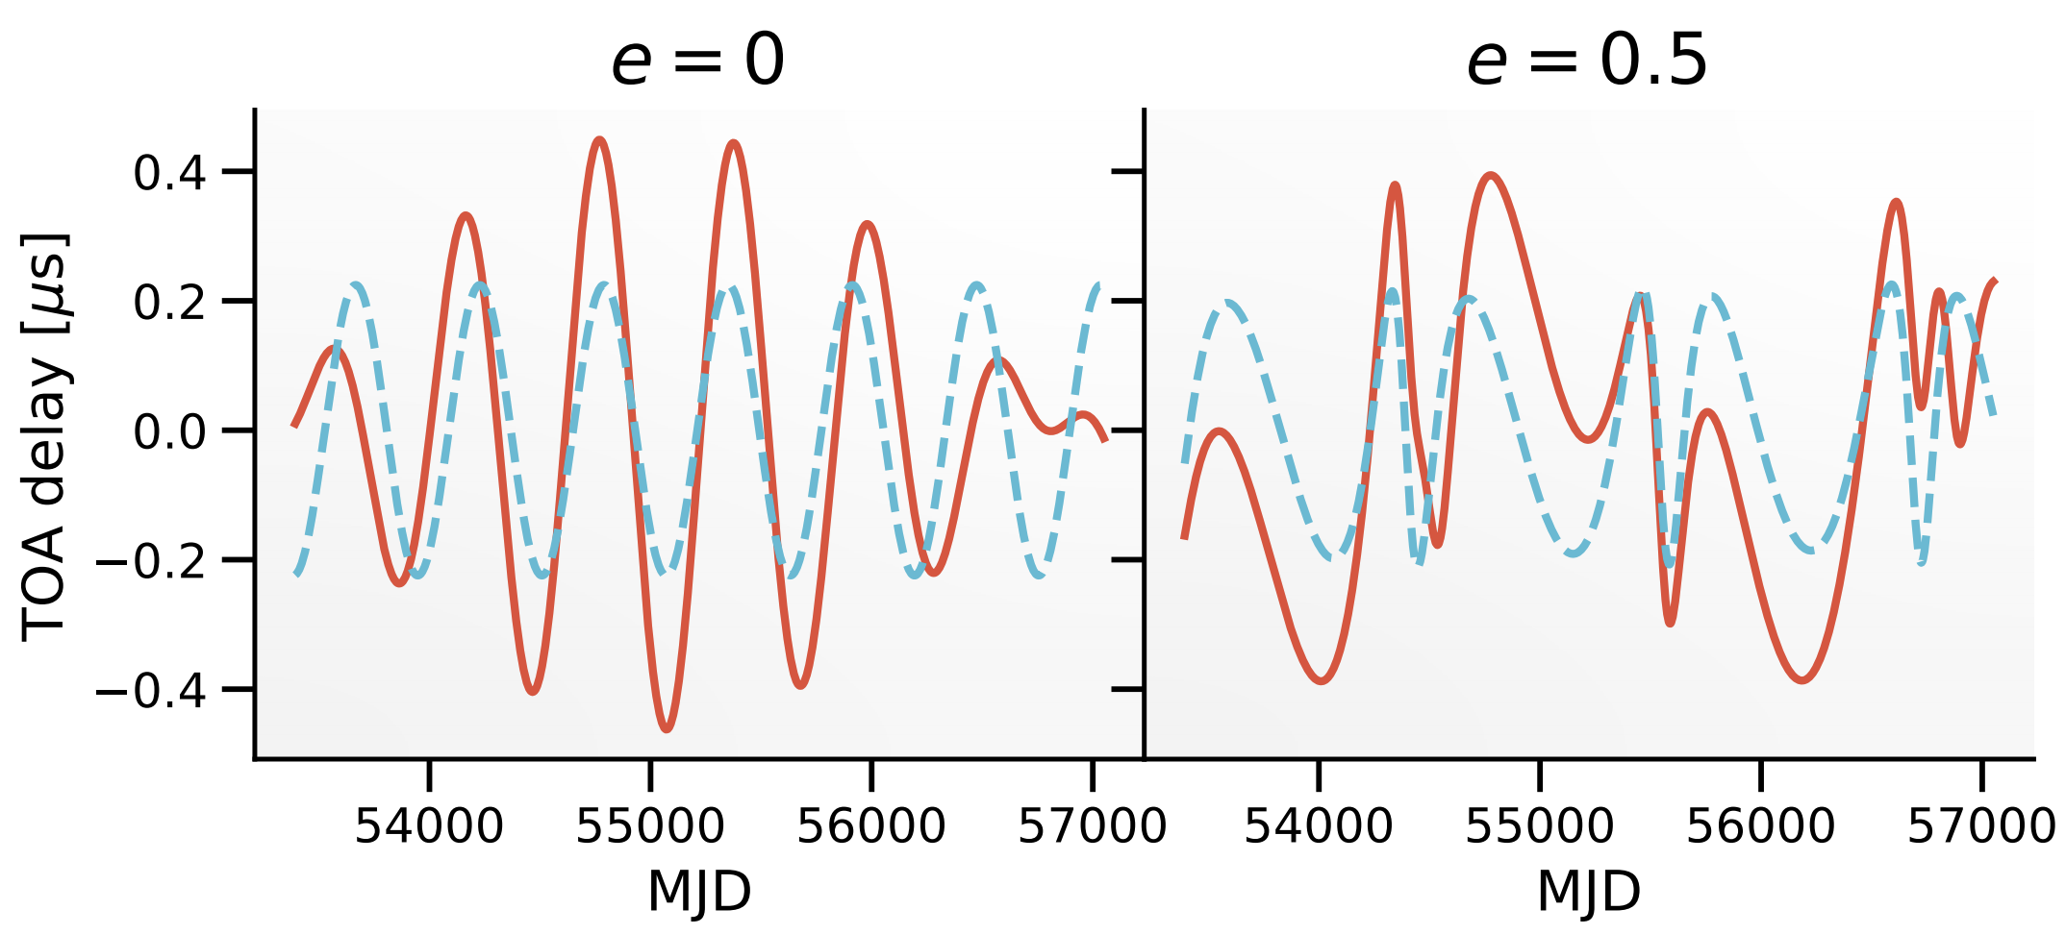
Image credit: Taylor (2021)
John Rowe Animation/Australia Telescope National Facility, CSIRO
Stephen R. Taylor
VU PTA GW Summer School | July 9 2024
Notes:
The redshift to the pulse arrival rate depends on geometric response factors (relative position of GW-source with respect to Earth-pulsar LOS), and the delta metric perturbation.
This is the difference in the GW metric perturbation at Earth and at the pulsar.
The so-called “Earth term” is felt by all pulsars. The “pulsar term” depends on the location and distance to the pulsar.
Typical offset (or “residual”) between observed pulse TOAs and modeled TOAs are ~tens to ~hundred nanoseconds.

Slide 7
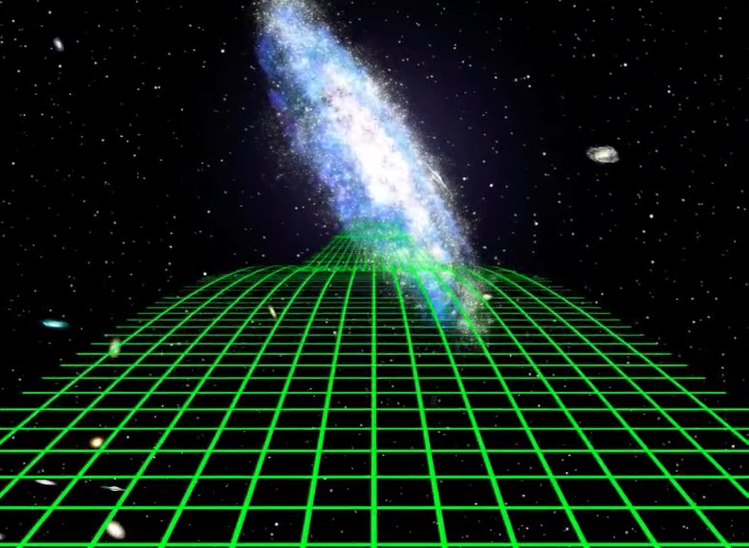
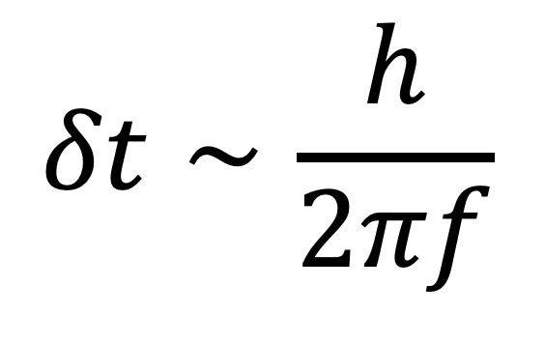
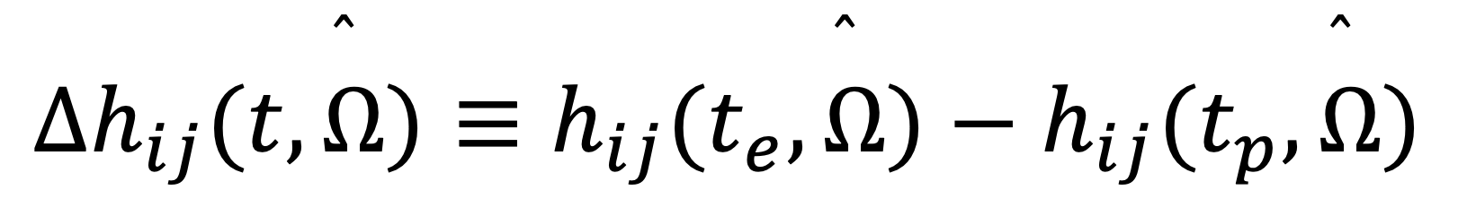
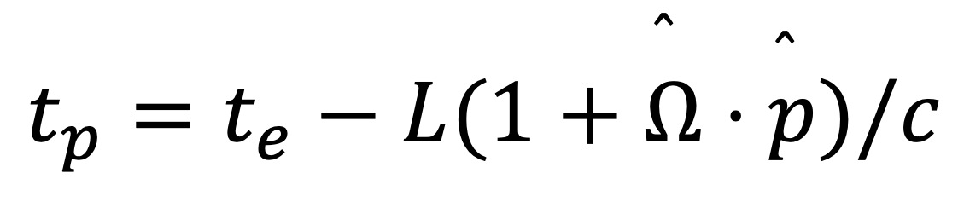
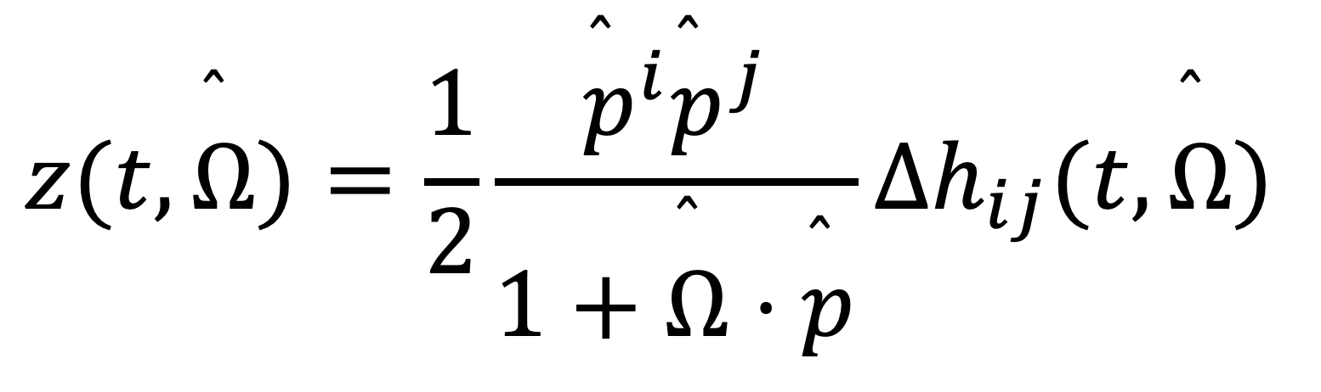
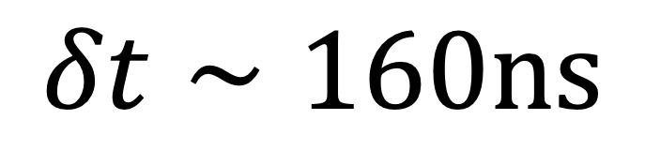
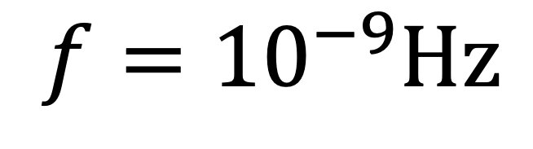
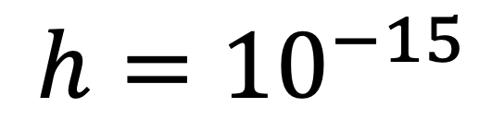
$$z(t,\overset{̂}{Ω})=\frac{1}{2}\frac{{\overset{̂}{p}}^{i}{\overset{̂}{p}}^{j}}{1+\overset{̂}{Ω}⋅\overset{̂}{p}}Δh_{ij}(t,\overset{̂}{Ω})$$
Pulsar Timing Arrays
$$Δh_{ij}(t,\overset{̂}{Ω})≡h_{ij}(t_{e},\overset{̂}{Ω})−h_{ij}(t_{p},\overset{̂}{Ω})$$
$$t_{p}=t_{e}−L(1+\overset{̂}{Ω}⋅\overset{̂}{p})/c$$
$$δt∼\frac{h}{2πf}$$
$$h={10}^{−15}$$
$$f={10}^{−9}Hz$$
John Rowe Animation/Australia Telescope National Facility, CSIRO
$$δt∼160ns$$
Stephen R. Taylor
VU PTA GW Summer School | July 9 2024
Notes:
The redshift to the pulse arrival rate depends on geometric response factors (relative position of GW-source with respect to Earth-pulsar LOS), and the delta metric perturbation.
This is the difference in the GW metric perturbation at Earth and at the pulsar.
The so-called “Earth term” is felt by all pulsars. The “pulsar term” depends on the location and distance to the pulsar.
Typical offset (or “residual”) between observed pulse TOAs and modeled TOAs are ~tens to ~hundred nanoseconds.

